Slide 1

Green University of Bangladesh Department of Computer Science and Engineering(CSE)
Faculty of Sciences and Engineering Semester: (Fall , Year:2022), B.Sc. in CSE (Day)
LAB REPORT NO : 2
Course Title : Structured Programming Lab
Section : DC
Course Code : CSE 104
Student Details
Name | ID
Md. Sohan Millat Sakib | 222902036
: 26-10-2022
Lab Date Submission Date : 01-11-22 Course Teacher’s Name
: JARIN TASNIM TONVI
[For Teachers use only: Don’t Write Anything inside this box]
Marks:.....
Comments:
Lab Report Status
Signature: Date:.........

Slide 2
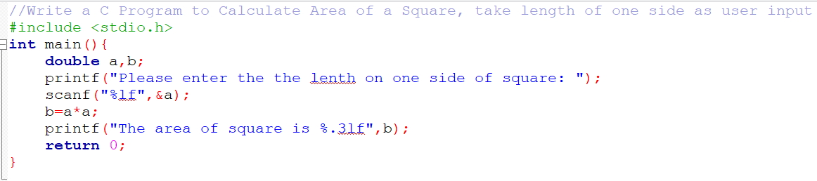
Problem 1:
Title: Write a C Program to Calculate Area of a Square, take length of one side as user input.
Objectives:
To be familiar with scanf and printf function.
Learn to solve the problem with arithmetic expressions.
Input & Output:
At first, we have to read the length of the square. Then calculate the square length of the square and print it.
Implementation:

Slide 3
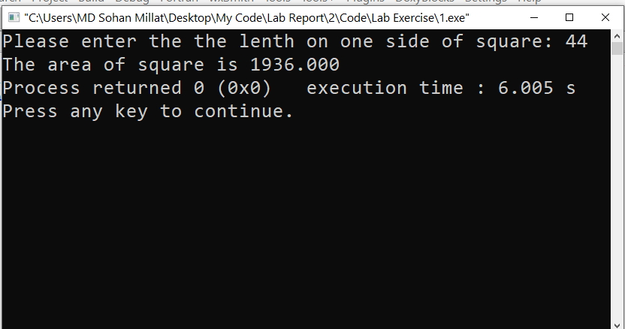
Test Result:
Discussion: I don’t face any problem solving this problem.
Problem 2:
Title: Write a C program to enter temperature in °Celsius and convert it into °Fahrenheit.
Objectives:
To be familiar with scanf and printf function.
Learn to solve the problem with arithmetic expressions.
We have to know about Celcius to Farenheit law.
Input & Output:
At first, we have to read Celcius value.Then applying Celcius farenheit relation find out the Farenheit value..And print it.

Slide 4
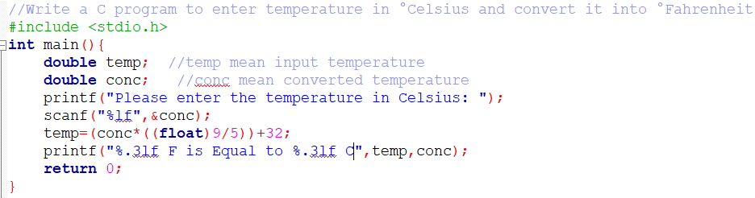
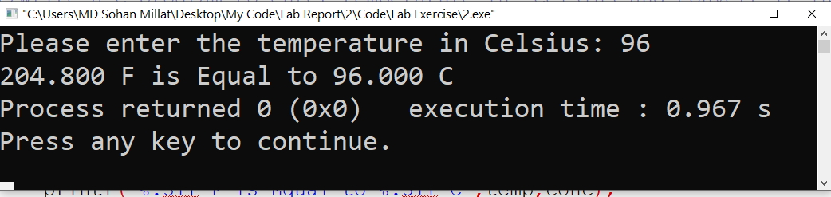
Implementation:
Test Result:
Discussion: This programme will find out the temperature value in farenheit. I don’t face any problem solving this question.

Slide 5
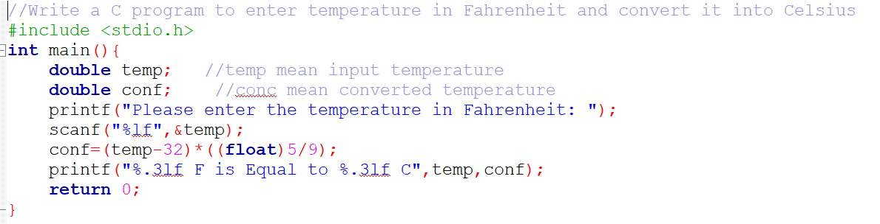
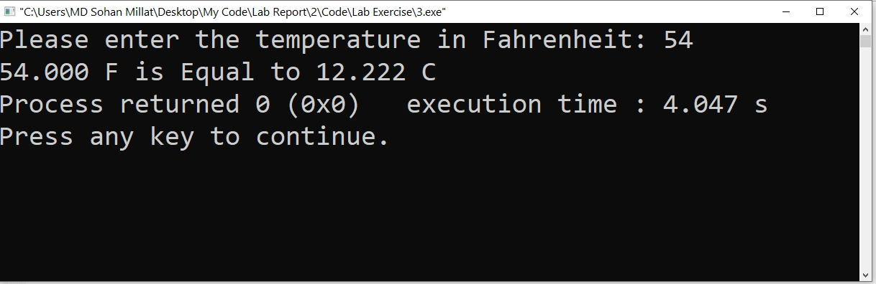
Problem 3:
Title: Write a C program to enter temperature in Fahrenheit(°F) and convert it into Celsius(°C)
Objectives:
To be familiar with scanf and printf function.
Learn to solve the problem with arithmetic expressions.
We have to know about Farenheit and Celcius relation.
Input & Output:
At first, we have to read Farenheit value.Then applying Celcius farenheit relation find out the Celcius value..And print it.
Implementation:
Test Result:

Slide 6
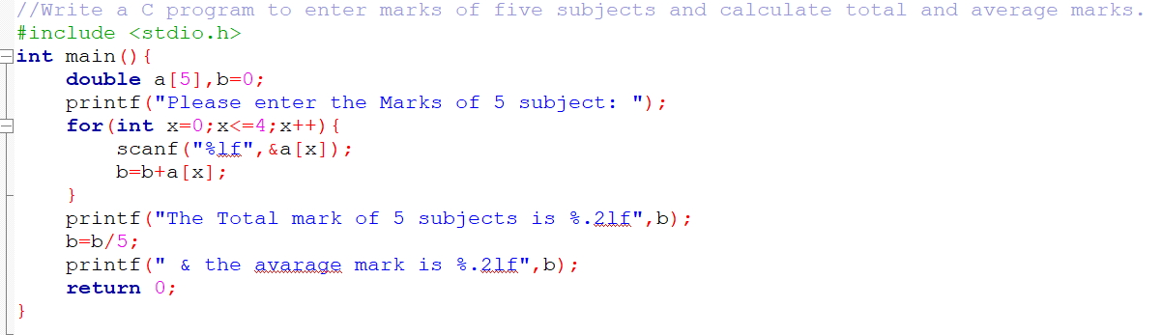
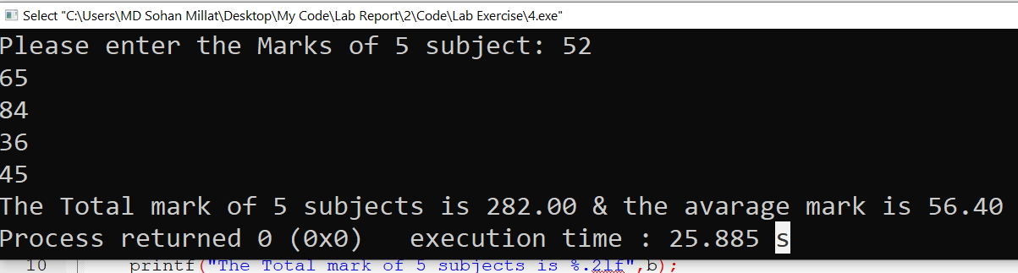
Discussion: This programme will find out the temperature value in Celsius. I don’t face any problem solving this question.
Problem 4:
Title: Write a C program to enter marks of five subjects and calculate total and average marks.
Objectives:
To be familiar with scanf and printf function.
Learn to solve the problem with arithmetic expressions.
Input & Output:
At first, we have to read five value as subject number. Then it is divided by 5.And then print it.
Implementation:
Test Result:

Slide 7
Discussion: This programme will show the average number of subject. I don’t face any problem solving this question.

